Slide 1
Dave Glover
Windows 10 for IoT
Microsoft
Developer Evangelist
m: dglover@microsoft.com
t: @dglover

Slide 2


Slide 3
This session is:-
Part Enterprise
Part Maker
Part Fun
All source code at https://github.com/gloveboxes

Slide 4
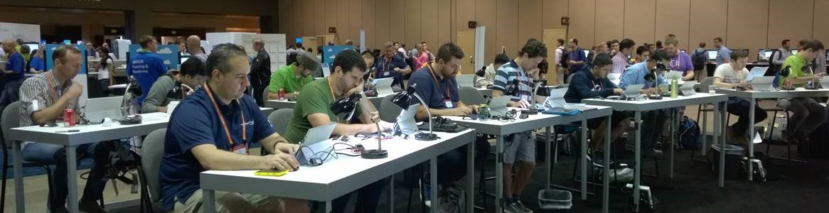
The Maker Den and Windows 10 IoT Core
All source and documentation at http://github.com/makerden

Slide 5
Windows 10 For IoT
Driving Forces
Opportunity
Development

Slide 6
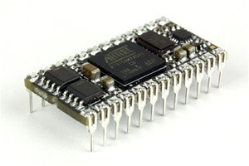

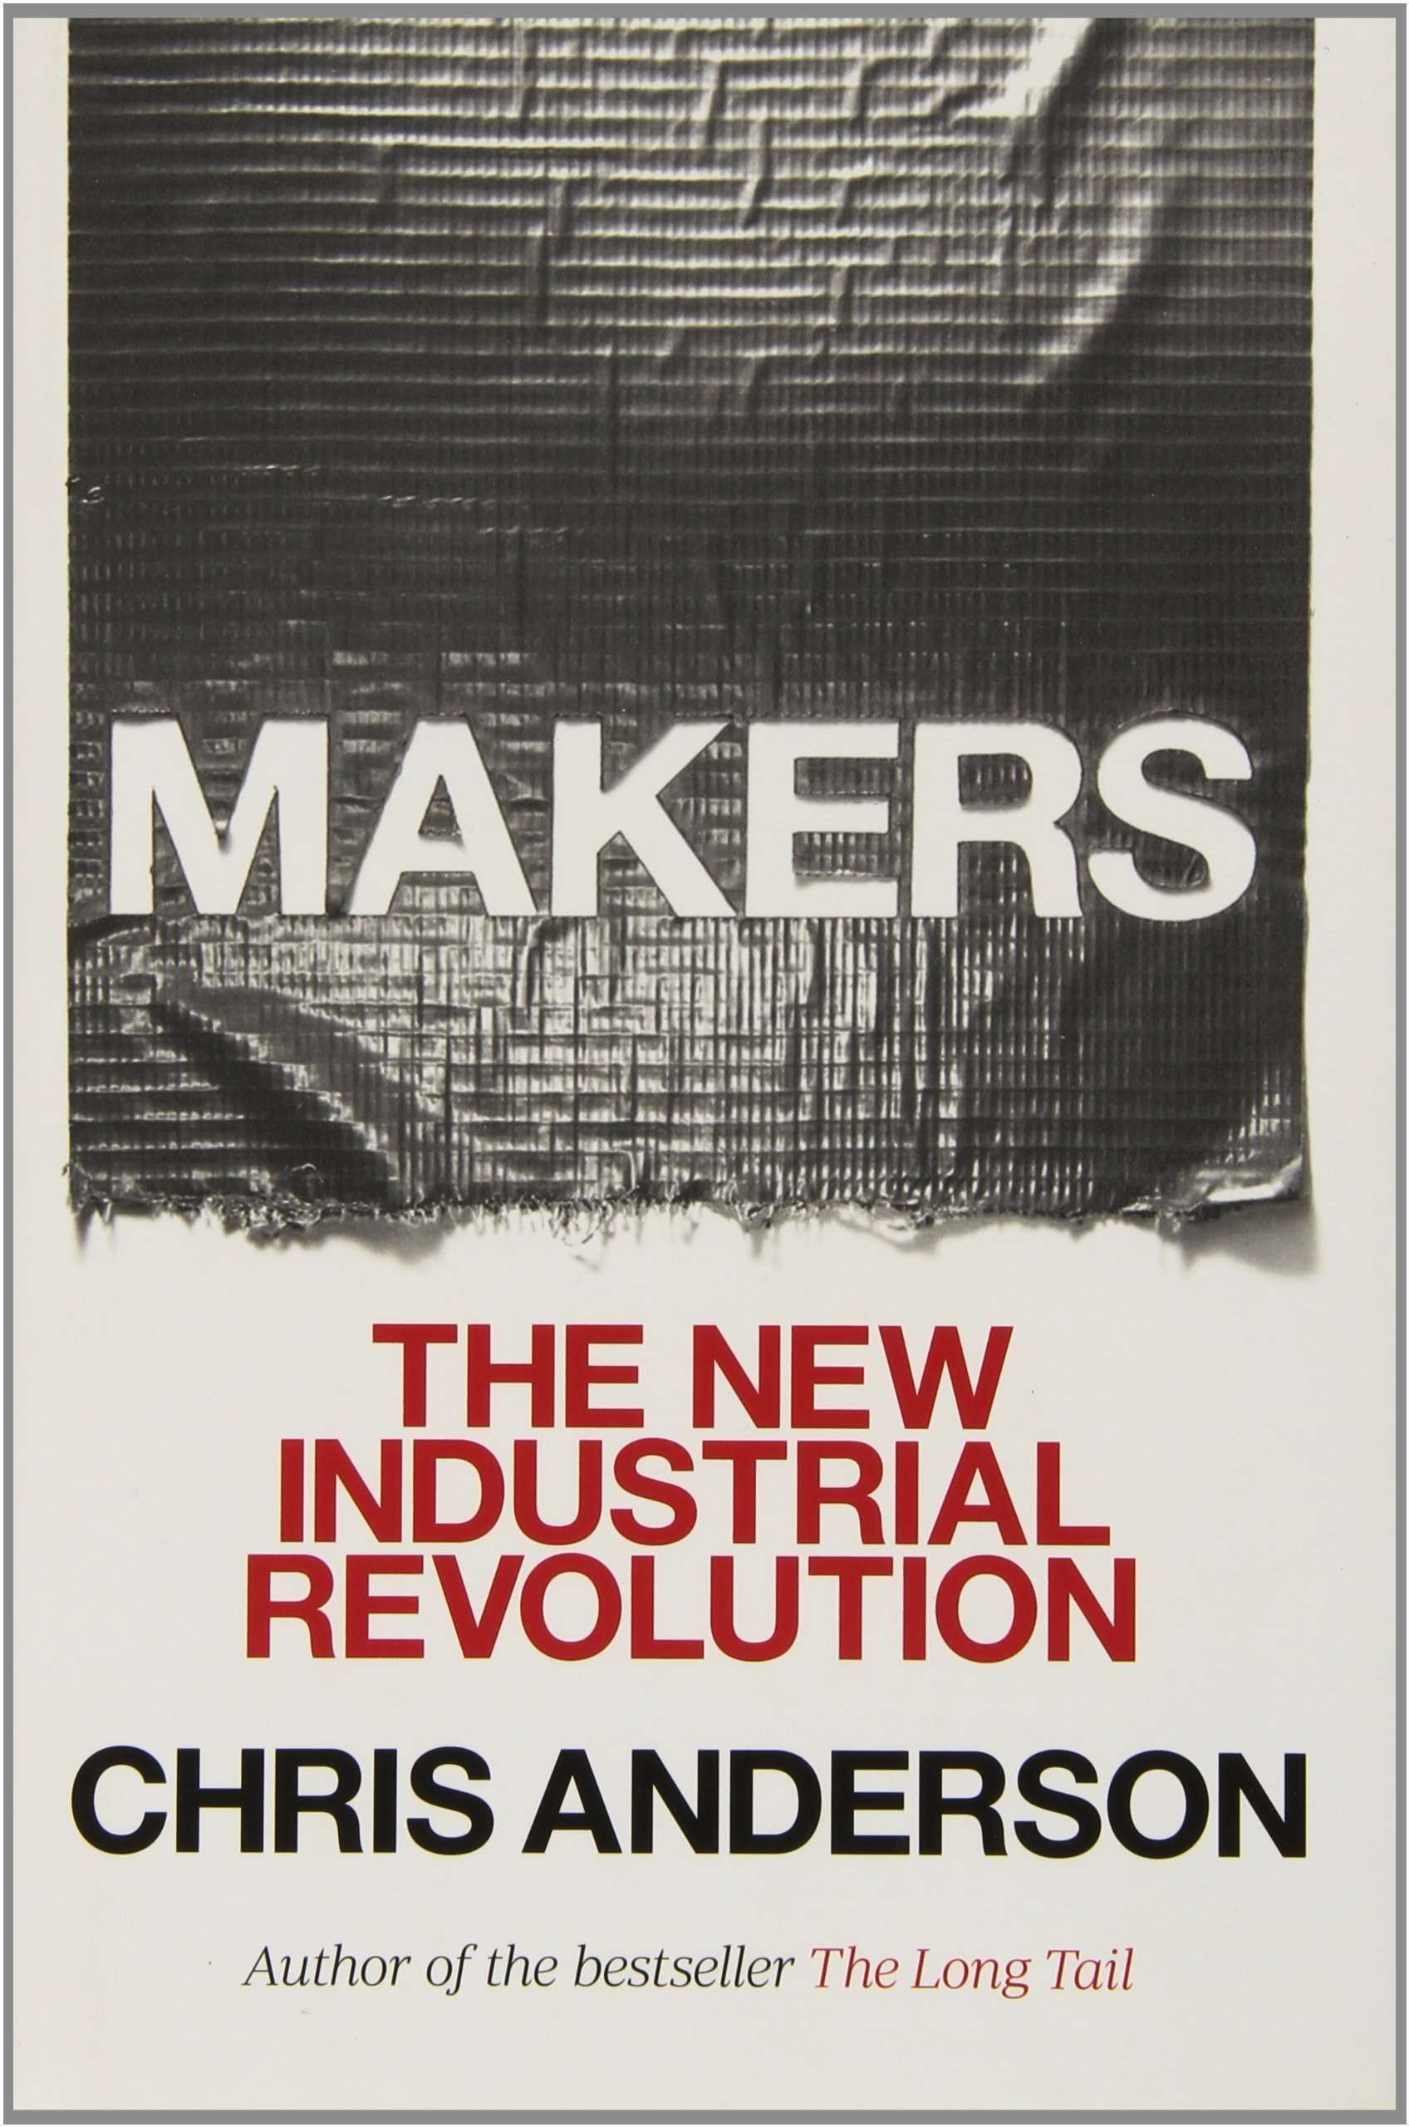
Driving Forces
Commoditisation
Silicon, Communications
Cloud Computing
Manufacturing inc 3D Printing
Access to Capital
Crowd Funding
Hunger for Knowledge
Big Data, Machine Learning, Visualization
Open Source Movement
HW & SW Platforms (msopentech.com)
The Maker Movement

Slide 7

Microsoft IoT Vision & Goals
Enable organizations transform their businesses by harnessing the power of intelligent devices and untapped data
Concept
Pilot
Commercialize
The Internet of Things starts with your things
Build for existing & new devices
Connect your devices & cloud to harness data
Enable rapid solution development
Notes:
Key Points:
1. Microsoft is building technology to help you build easily for both existing devices and new emerging devices be able to leverage the IoT opportunity
2. Device connectivity and Device-to-Cloud security are core aspects of our platform to enable organizations quickly transition their digital assets to the cloud.
3. Creating IoT solutions is often complex and takes time. We are creating solutions and programs to help with rapid solution development.
When we talk about IoT, we look at it from the perspective of partners and customers to help them to realize the value of data produced by the devices they create/use. Hence, it starts with the internet of your things.

Slide 8
Internet of Things opportunity
25 billion Connected “things” by 2020
—Gartner
70%
of value enabled by IoT will come from B2B scenarios
McKinsey & Company
$1.7 trillion
Market for IoT by 2020
—IDC
Notes:
Talking Points:
You’ve probably have heard a lot about IoT.
There’s a lot of noise out there and there are number of companies talking about IoT.
There are big numbers being thrown around.
According to latest IDC’s report, the IoT market is expected to be $1.7 trillion by 2020
Gartner predicts that there will be over $25 Billion connected “things” by 2020..
There is so much hype around IoT that IoT is beginning to sound like - If it’s a dumb thing, let’s just put a chip on it and voila you have smart thing..
Transition:
Once you get past all the confusion and noise and realize just how simple and powerful IoT can be, the next question becomes: “How to understand the core elements in an IoT architecture? Where should I focus to start going”

Slide 9



Interacting with people and environments
People
Things
Environments

Slide 10
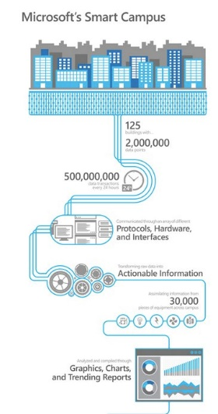

Microsoft Smart Campus
88 Acres Big Data Project
125 Buildings
500,000,000 Data points/day
30,000 Actionable items/day
10% Energy savings/annum
microsoft.com/citynext

Slide 11

WEARABLES

Slide 12

Notes:
Insurance on brink of the tech revolution
by Sam Stewart
6 October 2014
The offensive by digital disruptors on the financial services industry is about to launch on an entirely new front — insurance.
Unlike their cousins in the banking sector, insurers have been largely untouched by the digital revolution.
Many providers have built customer-friendly websites to allow online claims and payments but the core business of general, motor, health and life insurance is much the same as a decade ago.
Step back for a moment however and look at the insurance industry from the perspective of a digital disruptor with the technological tools already available.
Let’s start with the so-called “Internet of Things”. The number of internet-connected devices has grown exponentially over the past decade from less than one billion desktop computers to many billions of smart phones and tablets.
Over the next decade, the number of connected devices will be measured in the tens of billions. This will encompass small, low-cost sensors that can be placed in homes and cars to provide data that will allow much more accurate information about insurance risks.
For example, a sensor in the home will be able to detect a water leakage in real time. Sensors in cars will provide data about the location and usage patterns of the vehicle and therefore a more accurate fix on the risks of theft and accidents.
The Internet of Things also extends to people. Wearable technology such as the Apple Watch opens the door to mass-market availability of real-time data on health and fitness and new insights on risk for health and life insurers.
The idea of consumers embracing this technology is not a futuristic pipe dream. A recent survey by The Boston Consulting Group and Morgan Stanley of 500 Australian consumers found 80 per cent would be willing to share data from these kinds of sensors in exchange for a reduction in their premiums of about 10 per cent to 15 per cent.
Australians were more willing to share data than consumers in a number of other developed countries, including Germany, France, Japan and the UK, which perhaps reflects our disposition to be early adopters of technology.
The digital disruptor also has Big Data at is disposal to analyse all this new data and build powerful models for pricing risk. Digital technology has the potential to replicate many of the skills of the actuary and place under attack the core competitive advantage of insurers.
We’re not suggesting a doomsday for the global insurance industry but we do believe it is on the brink of major technology-driven change.
Technology will structurally change the types of data to assess risk and on our estimates could ultimately shrink the size of risk pools by up to $US109 billion worldwide — equivalent to 9 per cent of global non-life premiums.
In Australia, a number of our largest insurers have the advantage of having parents in the banking industry which has travelled much further than insurers along the digital journey. These insurers will be able to leverage their parents’ capability.
But the starting point for insurers is strategy. Technology will mean new types of players, a big departure for an industry that traditionally had very few adjacent entrants.
We believe insurers will need to orchestrate or join ‘ecosystems’ (networks of companies, individuals and institutions that interact and provide services) in order to promote, supply, install and service connected devices.
They will also need to ensure harmonious development of insurance offers, together with new applications and services to link with those devices.
An example of this trend is the partnership between Illinois-based State Farm and ADT for protected, connected homes.
Technology companies are moving in this direction to build connected-home offerings – for example, Google has acquired smart-home device maker Nest Labs and Samsung recently purchased home-automation company SmartThings.
The shift towards ecosystem-based insurance also reinforces the risk of adjacent entrants where non-insurers with key consumer insights from their own core operations seek to leverage that competitive advantage and offer their own insurance products.
From a strategic perspective, the key questions for insurers are ‘who will have the data I need in 10 years’ time?’ and ‘who will have the primary -, and more valuable - customer relationships?’
The time to start developing these strategies is now. While the technology-led revolution insurance is just beginning, experience in other industries shows it can be difficult to predict the pace of change in the business landscape.
Insurers also need to be mindful that there is a finite number of relevant potential partners for the new ecosystems that will shape the future of their industry.
Sam Stewart is a Partner, Financial Services, at The Boston Consulting Group

Slide 13
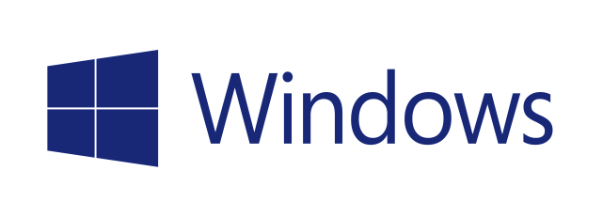


Powering The Next Generation of Intelligent Devices
10
One Windows
Platform
Secured
Connected
Universal Windows Platform
Universal Windows apps and driver
One deployment and management model
Enterprise-grade security
Granular UX Control and Advanced Lockdown
Device connectivity
Cloud connectivity
Notes:
Key points
One Windows Platform - Consistent management and deployment approach scalable across IoT devices
Secured - Defend against the latest security threats and provide a secure, predicable device experience with advanced lockdown capabilities
Connected – In-bound and out-bound connectivity for integrating sensors, peripherals and connecting to the cloud and other devices
One Windows Platform
Windows 10 IoT will be able to provide a consistent user experience across industry devices as it scales from an ATM to a handheld to a Maker board, for example.
Windows 10 IoT will help streamline IT operations and save on IT costs through one management & deployment approach – the same as that for PCs and phones.
Businesses will also be able to save on app investments through Windows 10 IoT universal app platform that enables the same app to run across devices.
Secured
Enterprises can rely on Windows 10 IoT enterprise-grade security to help protect user identity through two-factor authentication, protect sensitive information through device data encryption, and protect unauthorized access through secured remote access.
Businesses can further lock down their devices for specific industry scenarios using Windows 10 IoT advanced lockdown capabilities – for example, authorizing a user role a specific set of LOB apps, limiting input device access on a kiosk, or blocking pop-ups on a digital sign.
Windows 10 IoT will be the platform on which Microsoft will continue to provide innovation and support for industry devices.
Connected
Businesses will able to use more retail peripherals with universal apps in Windows 10 IoT while developers will have access to additional industry-standard networking and GPIO support in building IoT devices.
Businesses will be able to connect Windows 10 IoT devices to Azure cloud services as well as other industry-standard cloud service providers.
Microsoft will deliver a unique Device-as-a-Service solution, providing device telemetry, configuration, and updates – all helping to combine devices + cloud and create ambient intelligence.

Slide 14
Windows 10 IoT Editions
Windows 10 IoT Enterprise
1 GB RAM, 16 GB Storage
X86
Windows 10 Enterprise for IoT devices
Enterprise Manageability and Security
Rich user experience
Win32 & UWP
Windows 10 IoT Mobile
512 MB RAM, 4 GB storage
ARM
Windows 10 Mobile Enterprise for IoT devices
Handheld devices
Modern Shell & UWP
lockdown and multi-user support
Windows 10 IoT Core
256MB RAM, 2GB storage
X86 or ARM
New Windows 10 version for IoT devices
Optimized for small & low cost IoT devices
Single UWP App experience
Low cost silicon
Notes:
When we launched, Windows 10 this July, we created an converged platform that can serve devices from desktops to PC to the IoT devices. We introduced 3 new editions for IoT Devices.
Windows 10 IoT Enterprise – This is the same Windows 10 Enterprise licensed for IoT devices market. It provides a rich set of functionalities to build powerful, high performance industry devices.
Windows 10 IoT Mobile Enterprise – This is the same Windows 10 Mobile Enterprise edition licensed for the IoT devices market to build ruggedized and industry handheld devices. With Windows 10, it gets on par experience with the Enterprise in a number of aspects and include a Modern shell and advanced lockdown capabilities
Windows 10 IoT Core – This is a new edition that we released for building small and low cost IoT devices that provides a single purpose device experience with modern UWP app support and low cost silicon support.

Slide 15
Windows 10 IoT Editions
Windows 10 IoT Enterprise
1 GB RAM, 16 GB Storage
X86
No new updates in this release
Windows 10 IoT Mobile
512 MB RAM, 4 GB storage
ARM
Released to OEMs
Windows 10 IoT Core
256MB RAM, 2GB storage
X86 or ARM
Released to OEMs
New SKU to control updates
Notes:
When we launched, Windows 10 this July, we created an converged platform that can serve devices from desktops to PC to the IoT devices. We introduced 3 new editions for IoT Devices.
Windows 10 IoT Enterprise – This is the same Windows 10 Enterprise licensed for IoT devices market. It provides a rich set of functionalities to build powerful, high performance industry devices.
Windows 10 IoT Mobile Enterprise – This is the same Windows 10 Mobile Enterprise edition licensed for the IoT devices market to build ruggedized and industry handheld devices. With Windows 10, it gets on par experience with the Enterprise in a number of aspects and include a Modern shell and advanced lockdown capabilities
Windows 10 IoT Core – This is a new edition that we released for building small and low cost IoT devices that provides a single purpose device experience with modern UWP app support and low cost silicon support.

Slide 16
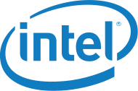



Windows 10 IoT Core Commercial Platforms
Element14 group announced a new customization service for RPi2 partners.
NEW
Notes:
Below are the 3 platforms available for building Windows10
Intel:
Intel recently announced their Intel IoT gateway program targeted at Windows 10 IoT Enterprise and Windows 10 IoT Core.
Calypso Island goal is to ensure that Intel and Microsoft provide a secure and scalable IoT solution for OEMs and End Customers
Intel IoT gateways imaged w/ Windows 10 IoT targeted for Q4’2015
Qualcomm:
Qualcomm Dragonboard is now available to get started with developing on the Qualcomm platform with additional capabilities beyond what is already supported on other ARM platforms—DirectX graphics as well as onboard WiFi and Bluetooth. Device builders and software developers will now have greater choice in selecting a platform that best meets their needs.
Raspberry Pi 2:
With Raspberry Pi 2, Element14 group recently announced that they will provide a Raspberry Pi Customisation Service for OEMs to help in designing and manufacturing customised versions of the Raspberry Pi device portfolio in order to better meet their requirements. This will highly benefit our partners looking to build low cost devices using the RPi2 platform.

Slide 17
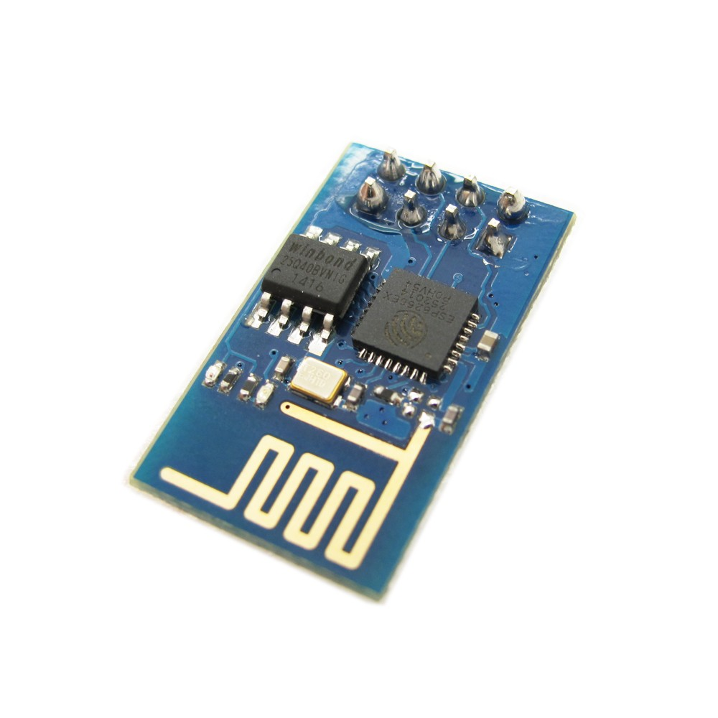
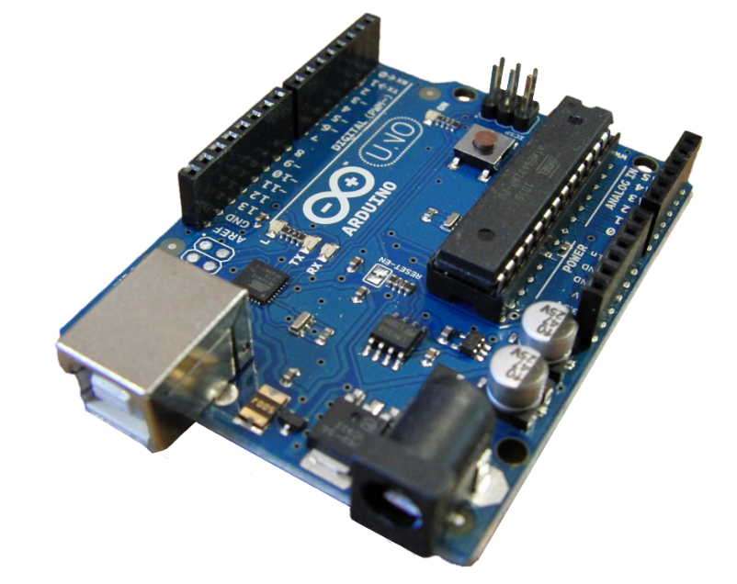
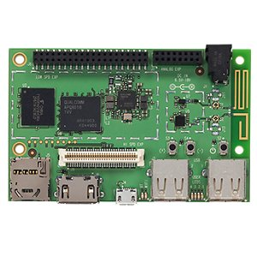
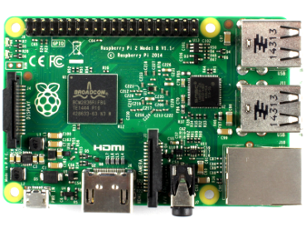
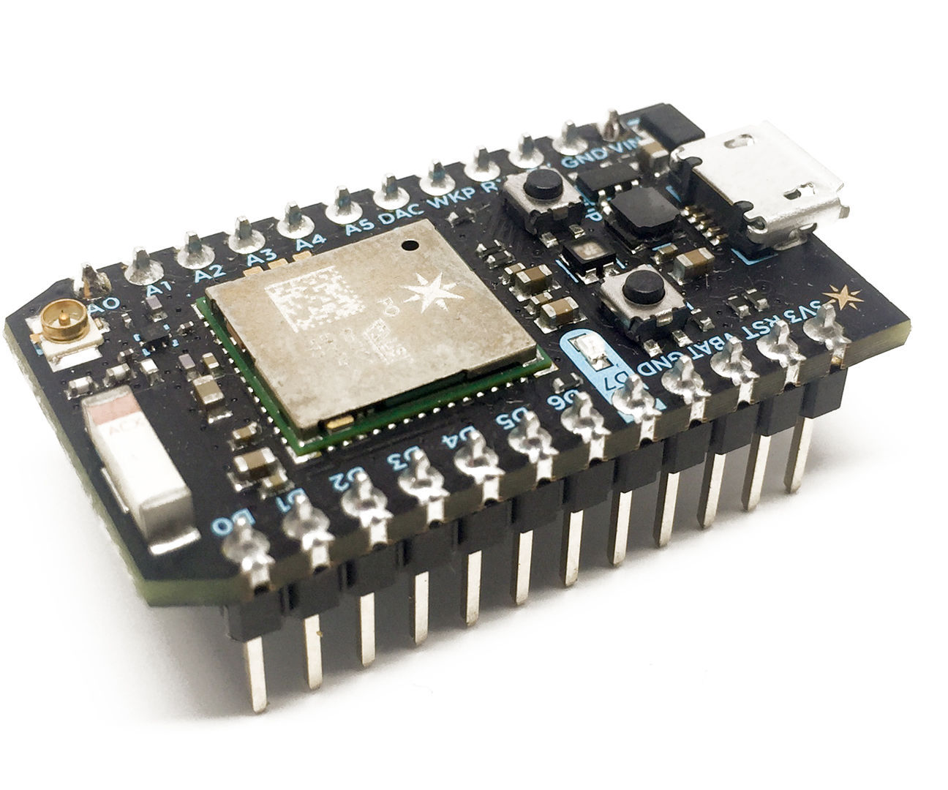
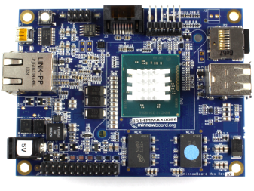
No One Sized Solution
Firmware based Runs against the Hardware Real Time Capabilities Limited resources Ultra Low Power | OS Based Advanced OS Capabilities (Networking, Security, Management) Advanced App Services More resources – Mem, CPU, Storage
Ardunio
ESP8266
Dragonboard 410c
Raspberry Pi 2
Particle Photon
MinnowBoard Max

Slide 18

Our Windows convergence is almost complete
Xbox 360
Xbox One
Unified core and app platform
Converged
OS kernel
Windows 8
Windows 8.1
Converged
app model
Windows 10
Windows Phone 8.1
Windows Phone 8
Easy for users to get & stay current
Windows Phone 7.5
Windows on Devices

Slide 19
Application Development
Universal Windows Platform
Visual Studio 2015 Community Edition and above
Windows IoT SDK and Platform (License Free)
Headed and Headless Apps
Management Web Interface
Wireless network, time zone settings, input language, system shutdown/reboot
PowerShell Integration

Slide 20
Windows 10 IoT Core Demo
Getting Started
http://dev.windows.com/iot
http://Microsoft.hackster.com
IoT Core Watcher and Web Management

Slide 21
Application Development
Languages: C#, C++, Python, Node.JS, VB.NET…
Full Remote Debugging Experience
Windows IoT Extensions for the UWP
Exposes: GPIO, I2C, SPI, ADC, PWM, UART
Arduino Wiring for Windows 10 IoT Core Devices
Speech Services - Recognition and Synthesis
Secure Connected - Cloud and AllJoyn

Slide 22
Windows 10 IoT Core Demo
Building Headed Apps
Radar, PWM and Distance
https://microsoft.hackster.io/en-US/AnuragVasanwala/windows-10-iot-core-ultrasonic-distance-mapper-d94d63?ref=platform&ref_id=4087_trending___&offset=15

Slide 23
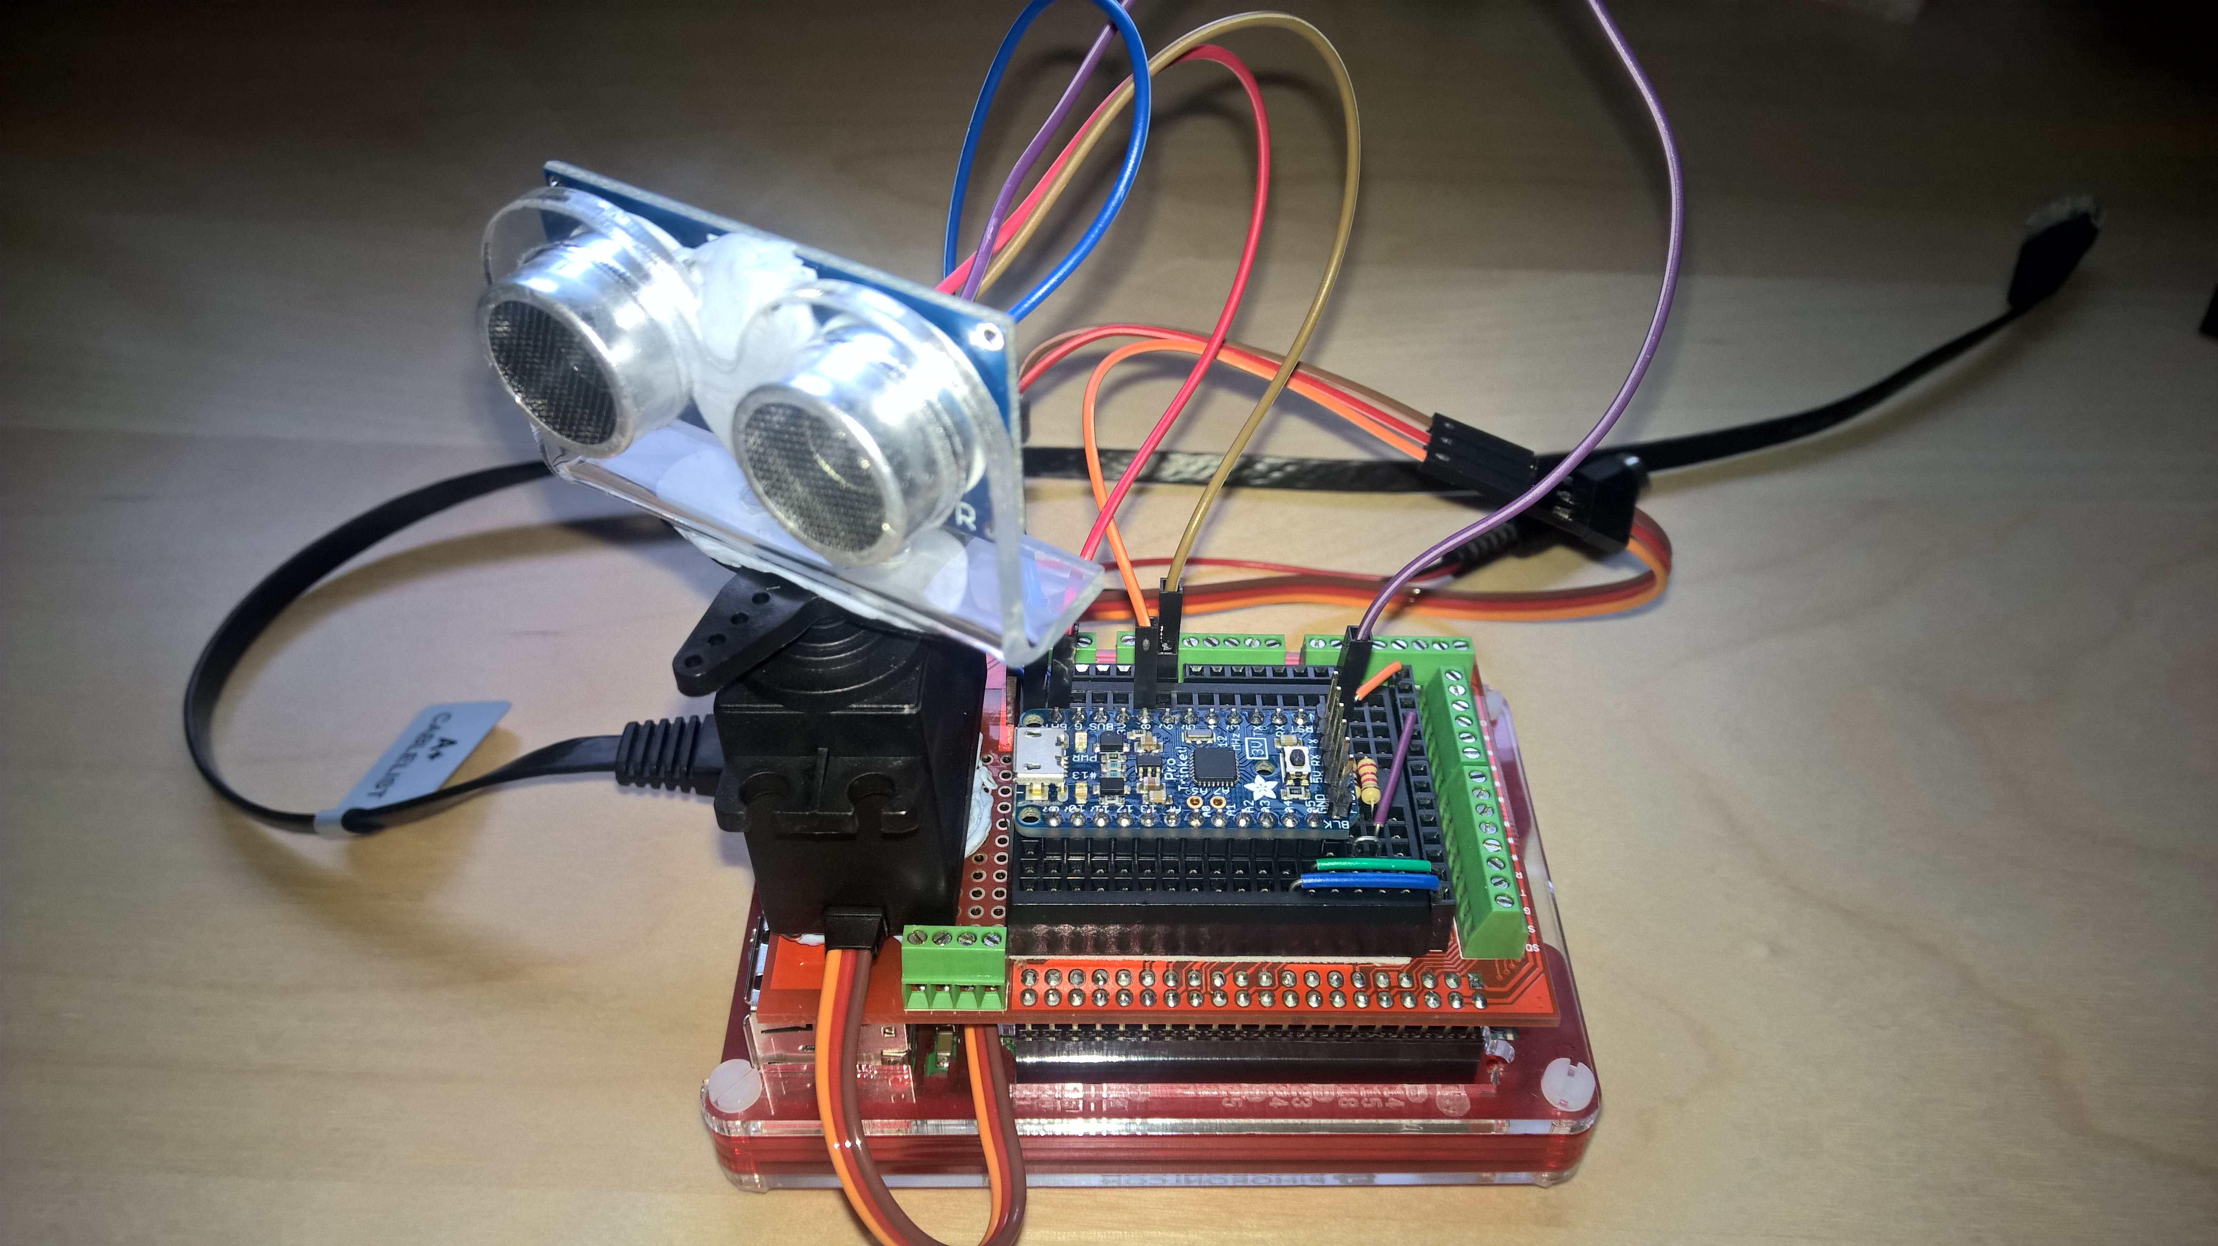
Raspberry Pi 2
Windows 10 IoT Core
Trinket Pro 3.3V Daughter Board

Slide 24
Windows 10 IoT Core Demo
Building Headless Apps
Rover Robot and Speech
Headless MediaElement - https://github.com/ms-iot/UniversalMediaEngine/pull/5

Slide 25
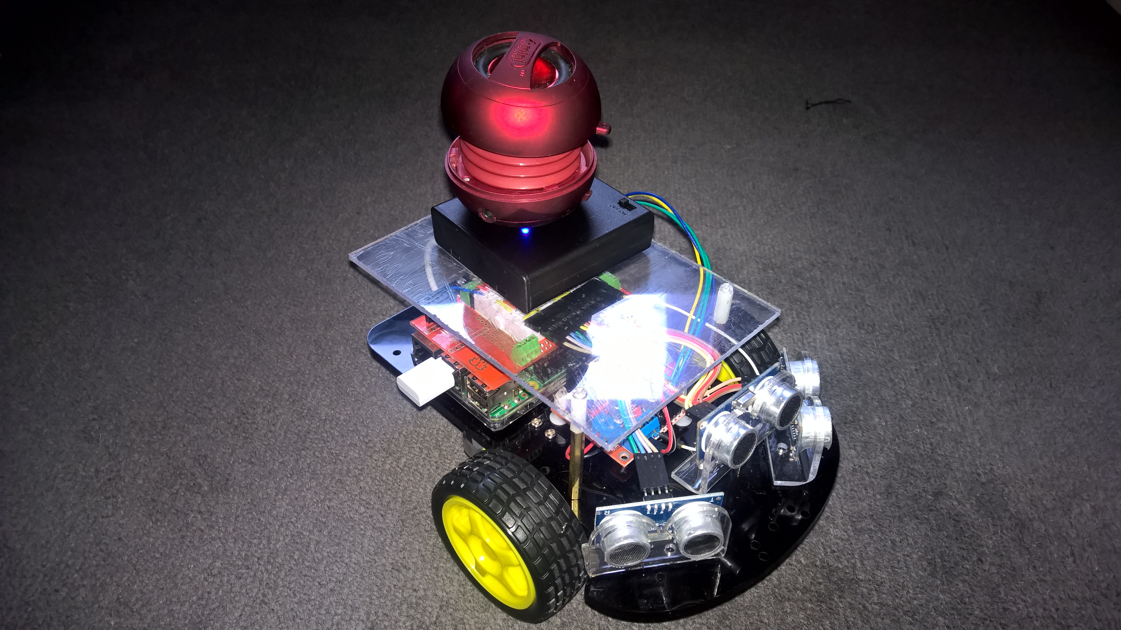

Slide 26



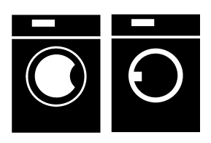








Interoperability and AllJoyn
DISCOVER nearby friendly devices
IDENTIFY services running on those devices
ADAPT to devices coming and going
MANAGE diverse transports
INTEROPERATE across different OSes
EXCHANGE information and services
SECURE against nearby bad actors
Notes:
Key points
The AllJoyn software framework is a collaborative open source project of the AllSeen Alliance. Microsoft has joined the AllSeen Alliance as a Premier member and is one of over a hundred members. AllJoyn enabled devices describe their capabilities via service interfaces on the virtual bus.
AllJoyn is integrated into Windows 10 core framework, so its available to all Windows 10 devices
Developers can easily create Universal Windows Apps for AllJoyn-Enabled Devices
Expose C & WinRT APIs for AllJoyn & Universal Windows App platform integration
Microsoft contributes Windows platform fixes back to the Alliance including improving AllJoyn security
AllJoyn solves challenges …in an open interoperable way
Find nearby devices
Painlessly connect to those devices, regardless of brand
Discover services running on those devices
Adapt to devices coming and going
Deal with different transports
Interoperate across different OSes
Exchange information and services
Provide reliable performance in wireless environments
Ensure no one nearby maliciously hacks into your phone

Slide 27
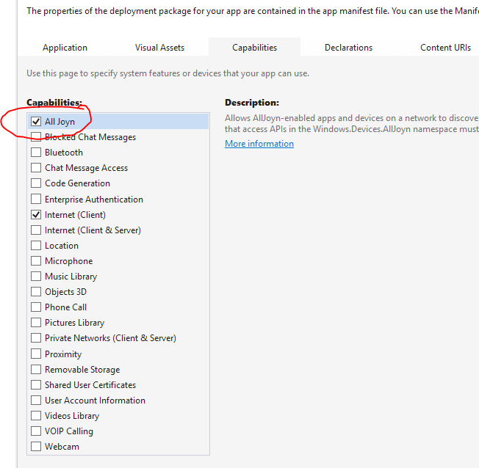
Visual Studio AllJoyn Support
Visual Studio Templates
AllJoyn Producer
AllJoyn Device System Bridge Template
AllJoyn Consumer
AllJoyn Studio
Must add AllJoyn Capability

Slide 28
Windows 10 IoT Core Demo
https://allseenalliance.org/alliance/members
AllJoyn Studio
Rover project
Building Headless Apps
AllJoyn walk through and AllJoyn Explorer

Slide 29
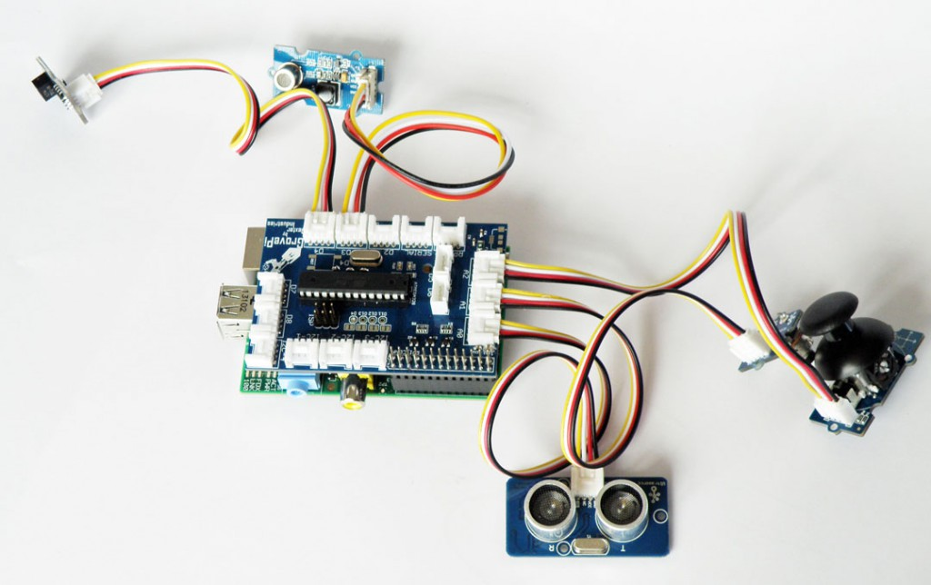
GrovePi Plug and Play
Minimal Electronics Knowledge Required
Windows IoT Core Driver Set
https://github.com/DexterInd/GrovePi/tree/master/Software/CSharp

Slide 30
Windows Iot Core and GrovePi

Slide 31
Resources
Getting Started
dev.windows.com/iot
microsoft.hackster.io
Drivers
https://github.com/ms-iot
https://github.com/gloveboxes
https://github.com/porrey

Slide 32
Where to buy
eBay and Amazon,
Little Bird Electronics,
Tronixlabs,
Core Electronics,
RS Components
Element14
Jaycars

Slide 33
Windows 10 IoT Core
Robust, Secure and Manageable
Azure Certified
Universal Windows Platform
Arduino Wiring Compatible
Language of your choice
Part of a Solution

Slide 34
The Maker Den and Windows 10 IoT Core
All source and documentation at http://github.com/makerden

Slide 35
Continue your Ignite learning path
Visit Microsoft Virtual Academy for free online training visit https://www.microsoftvirtualacademy.com
Visit Channel 9 to access a wide range of Microsoft training and event recordings https://channel9.msdn.com/
Head to the TechNet Eval Centre to download trials of the latest Microsoft products http://Microsoft.com/en-us/evalcenter/
Notes:
The purpose of this slide is to ensure delegates consider their next steps after your presentation. The learning should not end on 20th November 2015 ☺
Option to use this slide in the current generic format or for you to recommend 1 (or more) Microsoft Virtual Academy Course or Channel 9 video that is relevant next steps from your presentation.
Thanks

Slide 36
Dave Glover - @dglover
Windows 10 for IoT
What is it and how do you develop for it
MOB324

